Slide 2
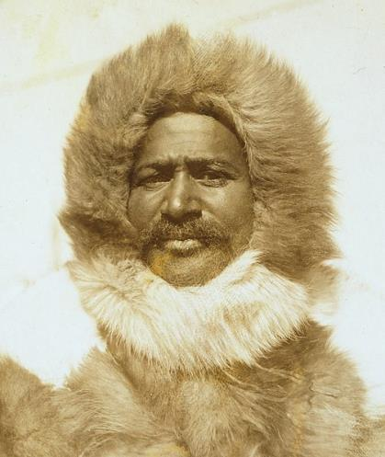
Who Was Matthew Henson?
Matthew Henson was a Black American explorer who made outstanding contributions in the fields of exploration, discovery and research.
Although he has been credited with being the first person to reach the North Pole, for many years the credit of this achievement went to Robert Peary, a White man who he worked for.
Peary claimed to have reached the North Pole on April 6th 1909. Modern calculations have demonstrated that they had reached the farthest point north in history but not the actual North Pole, which was only about 30 miles away from where they were.
Because Peary had lost eight toes to frostbite, Henson was the real leader of the expedition, as well as being ahead of Peary by 45 minutes when they actually stepped onto the northernmost point.
“I think I’m the first man to sit on top of the world.” – Henson on reaching the North Pole.

Slide 3
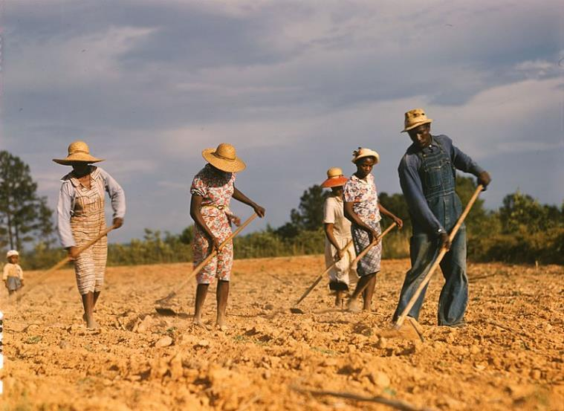
Childhood
Born in 1866, Henson grew up in the state of Maryland.
His parents were sharecroppers, which means that they had to give a share of their crops to the landowner of the lands that they cultivated.

Slide 4
Frederick Douglass
When Matthew Henson was 10, he listened to a speech from Frederick Douglass and was greatly inspired. Douglass was an abolitionist, a person who fights against slavery, who himself had been enslaved in Maryland and had escaped. He wrote and spoke against slavery and defended the rights of Black people. His words made young Henson realise that he could do whatever he put his mind to.

Slide 5
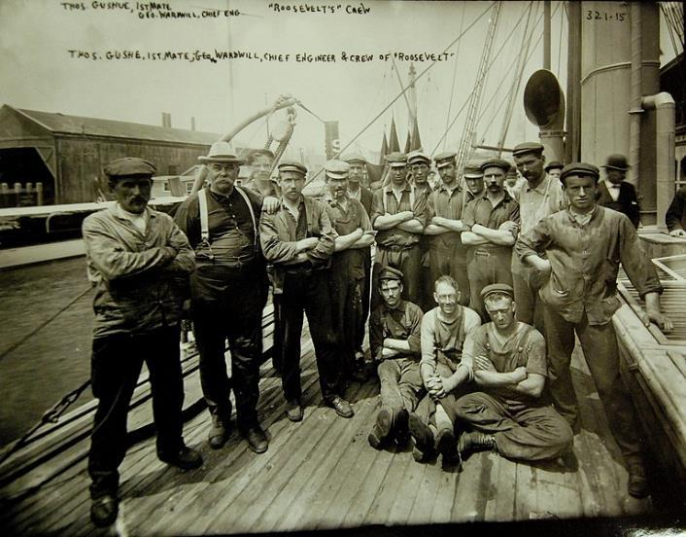
An Orphan and a Sailor
By the age of 12, Henson had lost both his parents, yet he had received an education thanks to an uncle who had taken him in and sent him to school.
He then joined a ship crew as a cabin boy and travelled around the world, visiting countries, such as China, Japan, North Africa, Spain, France and Russia.
The captain of the ship always treated him fairly but when he died, Henson was not able to find another ship where he could be treated as an equal.
“Captain Robert Peary’s North Pole Expedition, 1905-06” by National Museum of the U.S. Navy is licensed under CC BY 2.0

Slide 6
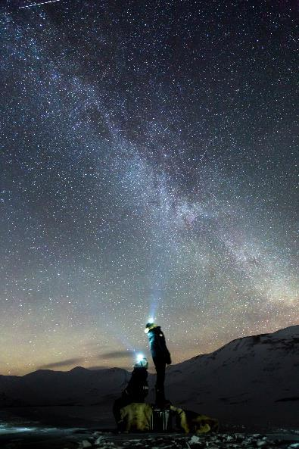
The Race for the Poles
In November 1887, Henson was working at a clothing store in Washington DC when naval officer Robert Peary walked into the store. Peary was so impressed with Henson’s sea experience that he employed him to accompany him on a trip to Nicaragua.
Henson went on to spend more than 20 years travelling with Peary. They went on eight expeditions to the Arctic region. They were both determined to be the first people to set foot on the North Pole.
They learned many survival techniques from the Inuit.
Click on the word in bold to learn more about the Inuit.

Slide 7
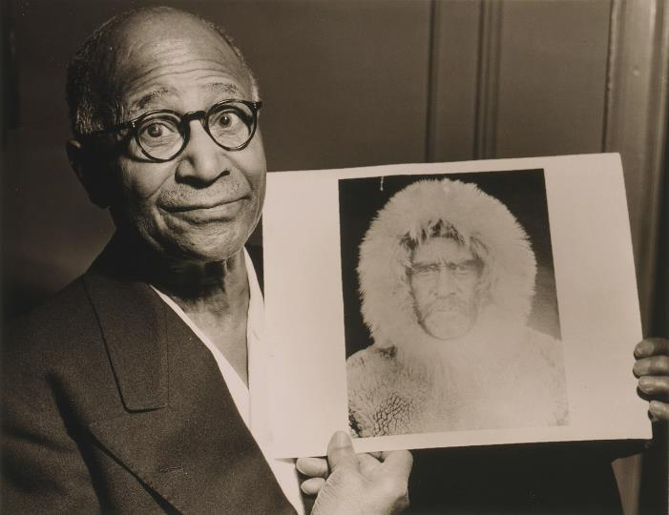
Peary and Henson
Robert Peary and Matthew Henson had a complicated relationship.
Henson was vital to the success of Peary’s expeditions and in his foreword to Henson’s book A Negro Explorer at the North Pole, published in 1912, Peary wrote words full of praise for Henson.
However, when on expeditions, Peary did not wish to share his moments of glory with Henson. He even tried to leave Henson behind on one expedition so that he could claim to be the first man alone to reach the farthest north.

Slide 8
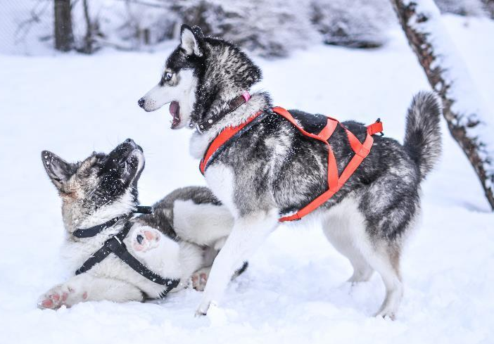
Surviving in the North Pole
One of the reasons why it was so difficult to reach the North Pole was the extreme weather conditions that people are exposed to in the Arctic region.
It was very important to carefully plan an expedition. Explorers had to make sure they took enough food with them, along with the right sort of equipment and the correct number of dogs to make sure the sleds could be pulled along the snow properly.
Did You Know…?
Norwegian explorer Amundsen, who was the first person to reach the South Pole, used dogs not only to pull the sleds that transported them but also as food.

Slide 9
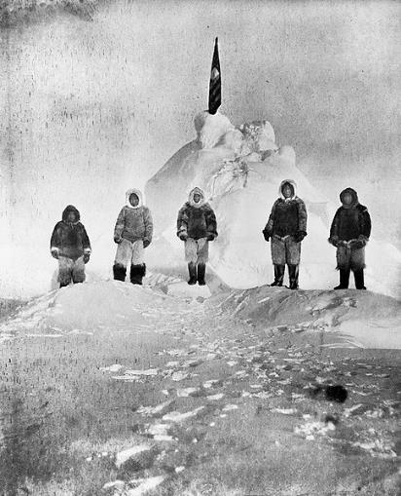
Reaching the North Pole
On their 8th expedition to the North Pole, Henson and Peary finally reached what they considered to be the North Pole.
On the morning of April 6th 1909, four Inuit men, Matthew Henson and Robert Peary set foot on what, according to Peary’s sextant, was the exact geographical North Pole.

Slide 10
The Controversy
Unlike the South Pole, which is firmly placed within the continent of Antarctica, the North Pole is located in the middle of the Arctic Ocean. The waters of the Arctic Ocean are almost permanently covered with constantly shifting ice.
When Matthew Henson and Robert Peary arrived back in the US after setting foot on what their measurements had told them was the North Pole, they were greeted by the news that another explorer, Frederick Cook, claimed to have reached the North Pole before them.
The controversy about who had reached the North Pole first was never quite settled. In fact, when searching the Internet about the first person to set foot on the North Pole, there are still conflicting arguments and different names given.

Slide 11
Henson’s Legacy
Despite the controversy, Matthew Henson achieved a great deal in his lifetime and his legacy continues.
By believing in himself and not giving in to the White supremacist people who attacked his family, he went further than any man had ever gone before.
His respect for other cultures, such as the Inuit, allowed him to learn from them and use this knowledge to go even further.

Slide 12
Inuit Knowledge
The Inuit are a group of indigenous peoples that have lived in the Arctic regions of Europe and North America for more than 5000 years.
Robert Peary and Matthew Henson learned a lot of survival techniques from the Inuit. Henson became fluent in their language and established important relationships with them, which enabled their expeditions to be successful.
Thanks to the knowledge he acquired, Henson personally built and maintained all of the sledges used in their expeditions. He also became an expert hunter, fisherman and dog handler.
Click here to return to the slide entitled ‘The Race for the Poles’.

Slide 13
Glossary
foreword – A short introduction to a book, usually written by another author, giving further information about the content of the text.
back
frostbite - Damage to parts of the body caused by freezing. The most common parts of the body that one can damage and lose are the fingers, the toes, the ears and the nose.
back
research - In-depth investigation of an area.
back
sextant - The main instrument used for navigation until the development of GPS technology.
back
White supremacist - A person who believes that the White race is superior to other races and that White people should have control over people of other races.
back

