Slide 1


Slide 3

1) Partition 14 into tens and ones.
2) Calculate 7 $+$ 6
3) 8 $+$ ___ $=$ 17

Slide 4

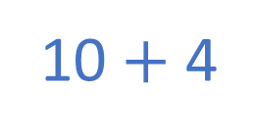
1) Partition 14 into tens and ones.
2) Calculate 7 $+$ 6
3) 8 $+$ ___ $=$ 17
10 $+$ 4
1 ten $+$ 4 ones
13
9

Slide 6
Mr Rose earns £124 on Monday.
He earns £138 on Tuesday.
How much does he earn in total?
£262
 | Hundreds | Tens | Ones
H | T | O
1 | 3 | 8
1 | 2 | 4
+
2
6
2
2
6
2
12
1

Slide 7





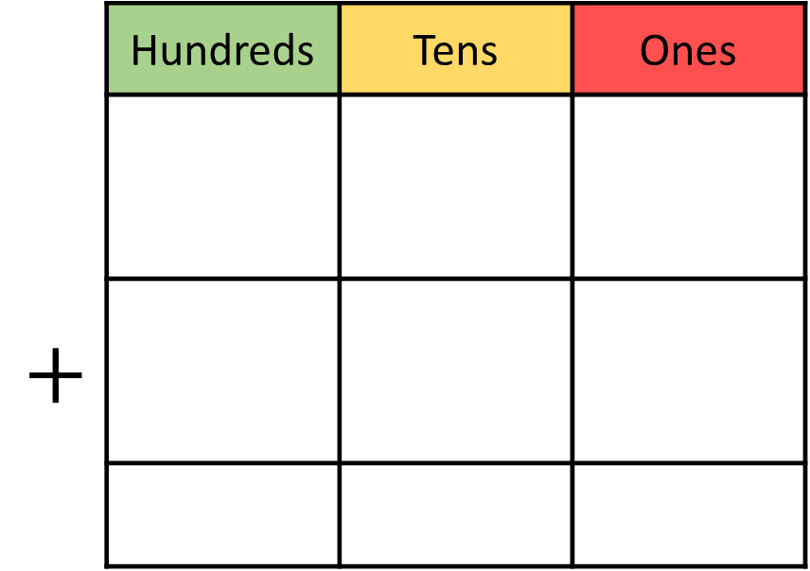
Dexter scores 351 points in a game.
Rosie scores 263 points.
How much do they score altogether?
614
 | Hundreds | Tens | Ones
$$+$$
H | T | O
3 | 5 | 1
2 | 6 | 3
6
1
4
6
1
4
1
Notes:
Can we simplify?
Discuss reduction structure – take away

Slide 8
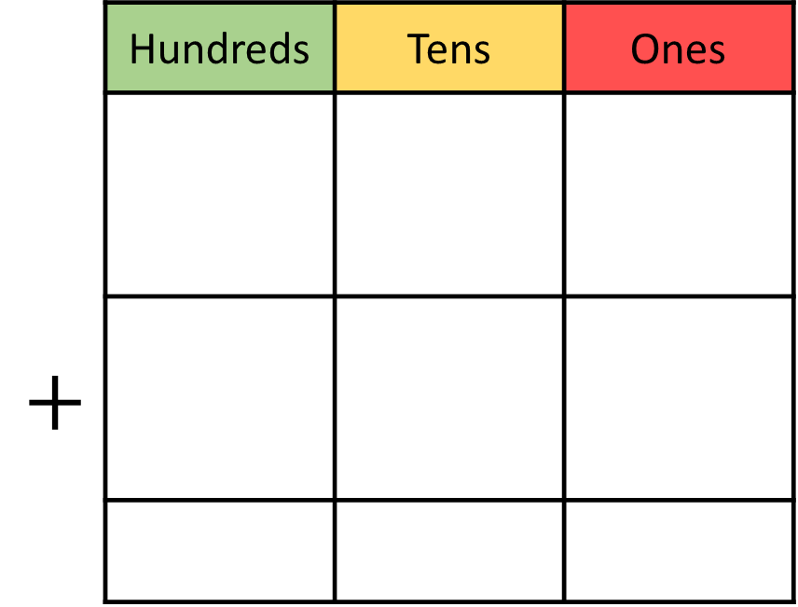
238 + 365 =
603
 | Hundreds | Tens | Ones
$$+$$
H | T | O
3 | 6 | 5
2 | 3 | 8
6
0
3
1
1
6
0
3

Slide 9
Have a go at questions 1 – 3 on the worksheet
Notes:
Can we simplify?
Discuss reduction structure – take away

Slide 10
713
422 + 273 =
715
+
=
178 + 154 =
2
The answer will have a _____ in the ones place.
+
=

Slide 11

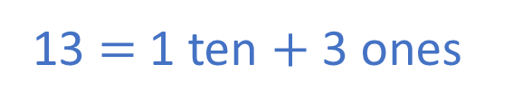
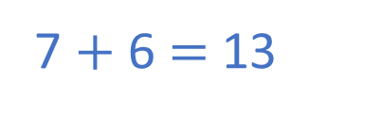
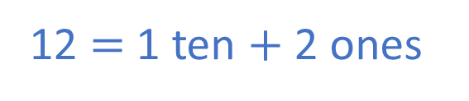
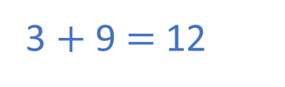
Have a think
1) 407 + 266 =
3
The answer will have a _____ in the ones place.
7 $+$ 6 $=$ 13
13 $=$ 1 ten $+$ 3 ones
2) 813 + 139 =
2
The answer will have a _____ in the ones place.
3 $+$ 9 $=$ 12
12 $=$ 1 ten $+$ 2 ones

Slide 12
Have a go at questions 4 – 5 on the worksheet
Notes:
Can we simplify?
Discuss reduction structure – take away

Slide 13
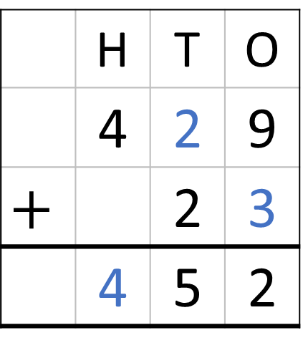
 | Hundreds | Tens | Ones
 | H | T | O
 | 4 | 2 | 9
$$+$$ |  | 2 | 3
 | 4 | 5 | 2
1
5
2

Slide 14

Have a go at the rest of the worksheet
Notes:
Can we simplify?
Discuss reduction structure – take away

