Slide 2
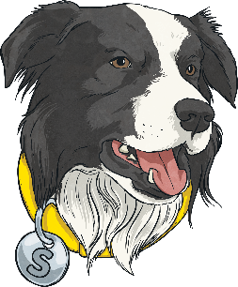
What Does Summarising Sheba Do?
Summarising Sheba helps with content domain 2c:
Summarise main ideas from more than one paragraph..
This means that she is there to help you to sum up what you’ve read.
She helps you to do this by reading the text, picking out the key points that are really important and giving a quick run down of the text’s main ideas.
Imagine that you’ve read a book and have to text your friend about the plot – which key messages would you tell them and which would you leave out?

Slide 3
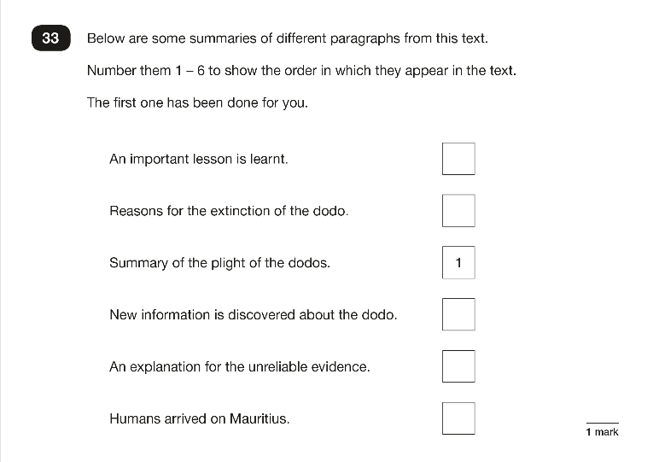
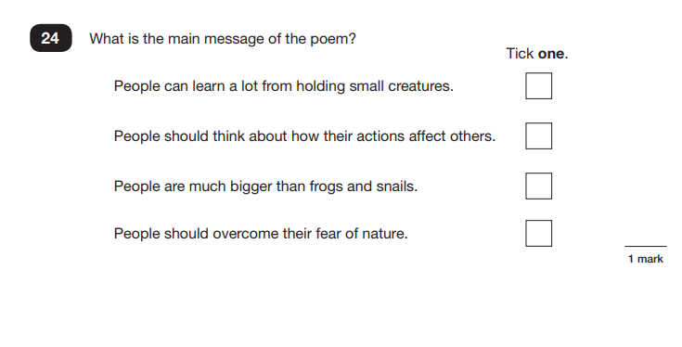
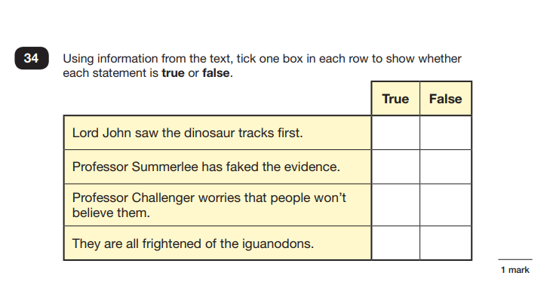
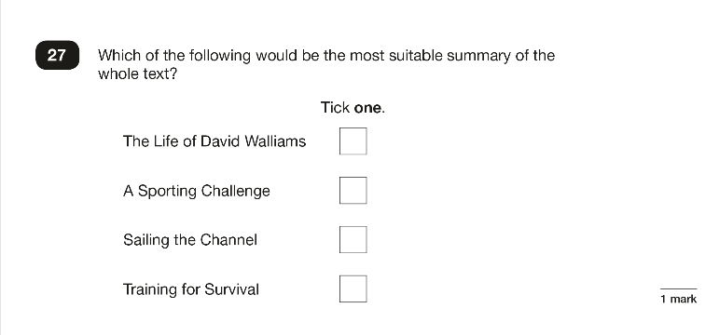
When Have We Seen
Summarising Sheba?
The kind of questions that Summarising Sheba helps with only usually appear a couple of times in SATs papers. Here are some recent examples:

Slide 4

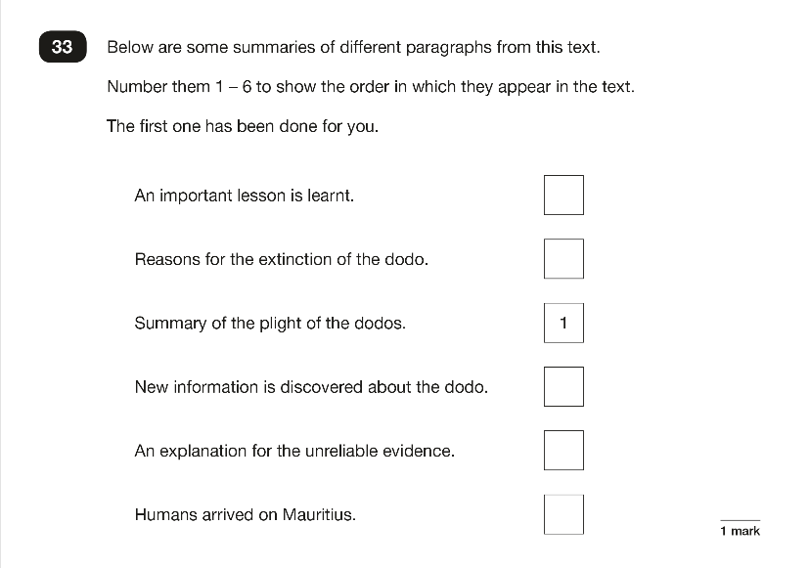
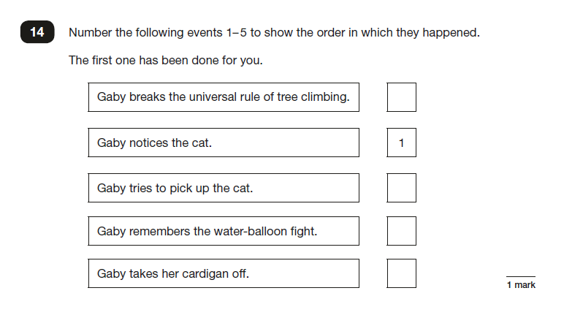
The ‘Number It’ Questions
Back
This type of question will give you multiple statements from or about the text.
You have to number them to show the order that they appear in the text.

Slide 5

The ‘New Title’ Questions
Back
This type of question will give you phrases which could be new titles for the text you have read. Based on your understanding of the text’s key points, you must choose the most suitable new title.
Sometimes, you may be asked to write your own suitable new title for the text.

Slide 6
The ‘Sum up the Message’ Questions
Back
This type of question will give you phrases which could sum up the key message of the text. Based on your understanding of the text’s key points, you must choose the most reasonable summary.
Sometimes, you may be asked to write your own summary of the text’s main message, moral or viewpoint.

Slide 7
The ‘True or False’ Questions
Back
This type of question will give you four different sentences which summarise what you have read.
It will ask you to tick whether they are true or false.
Be careful: the false sentences are purposely close to real things which happen within the text.

Slide 8
What Might Summarising Sheba Ask?
Back
Summarising Sheba might ask questions like these:
What is the main theme, argument or message of this paragraph?
Can you describe what happened in this chapter?
Write a new blurb for this story using 20 words or less.
Can you describe what happened in three short sentences?
How would you sum up…?
What is the most important message in this book?

Slide 9
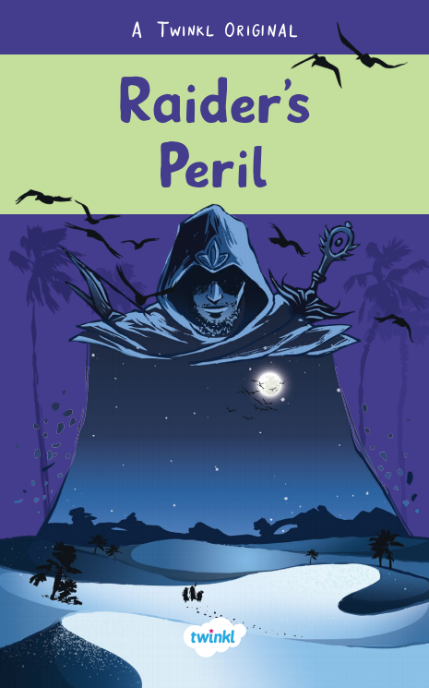
Let’s Explore Summarising Sheba Questions Together
Read the extract from Raider’s Peril and answer the questions as a class.
Click on the image to read the text.
Read the rest of the Raider’s Peril story here.

Slide 10
Let’s Explore Summarising Sheba Questions Together
Read the extract from Raider’s Peril and answer the questions as a class.
What is the main argument in the last two paragraphs? Tick one.
Catanna knew that she was truly unstoppable.
Catanna wanted to equip her guild with fire opal weapons.
Catanna had found topaz gems on her last raid.
Catanna was the leader of the Brittlestar guild.
This chapter is called Double Life. Based on what you have read so far, write a new title for the chapter.
Sum up what Catanna did with the topaz gems in less than 10 words.

Slide 11

Let’s Explore Summarising Sheba Questions Together
Read the extract from Raider’s Peril and answer the questions as a class.
Number the following events 1-5 to show the order in which they appear in the text. The first one has been done for you.
The workstation was covered with instruments.
Diamond, sunstone and fire opal are rarer than topaz.
The quartz spear glinted on the workstation. |  | 1
Fire opal weapons are revered across the White Desert.
Catanna had found the gems on her last raid.

Slide 12
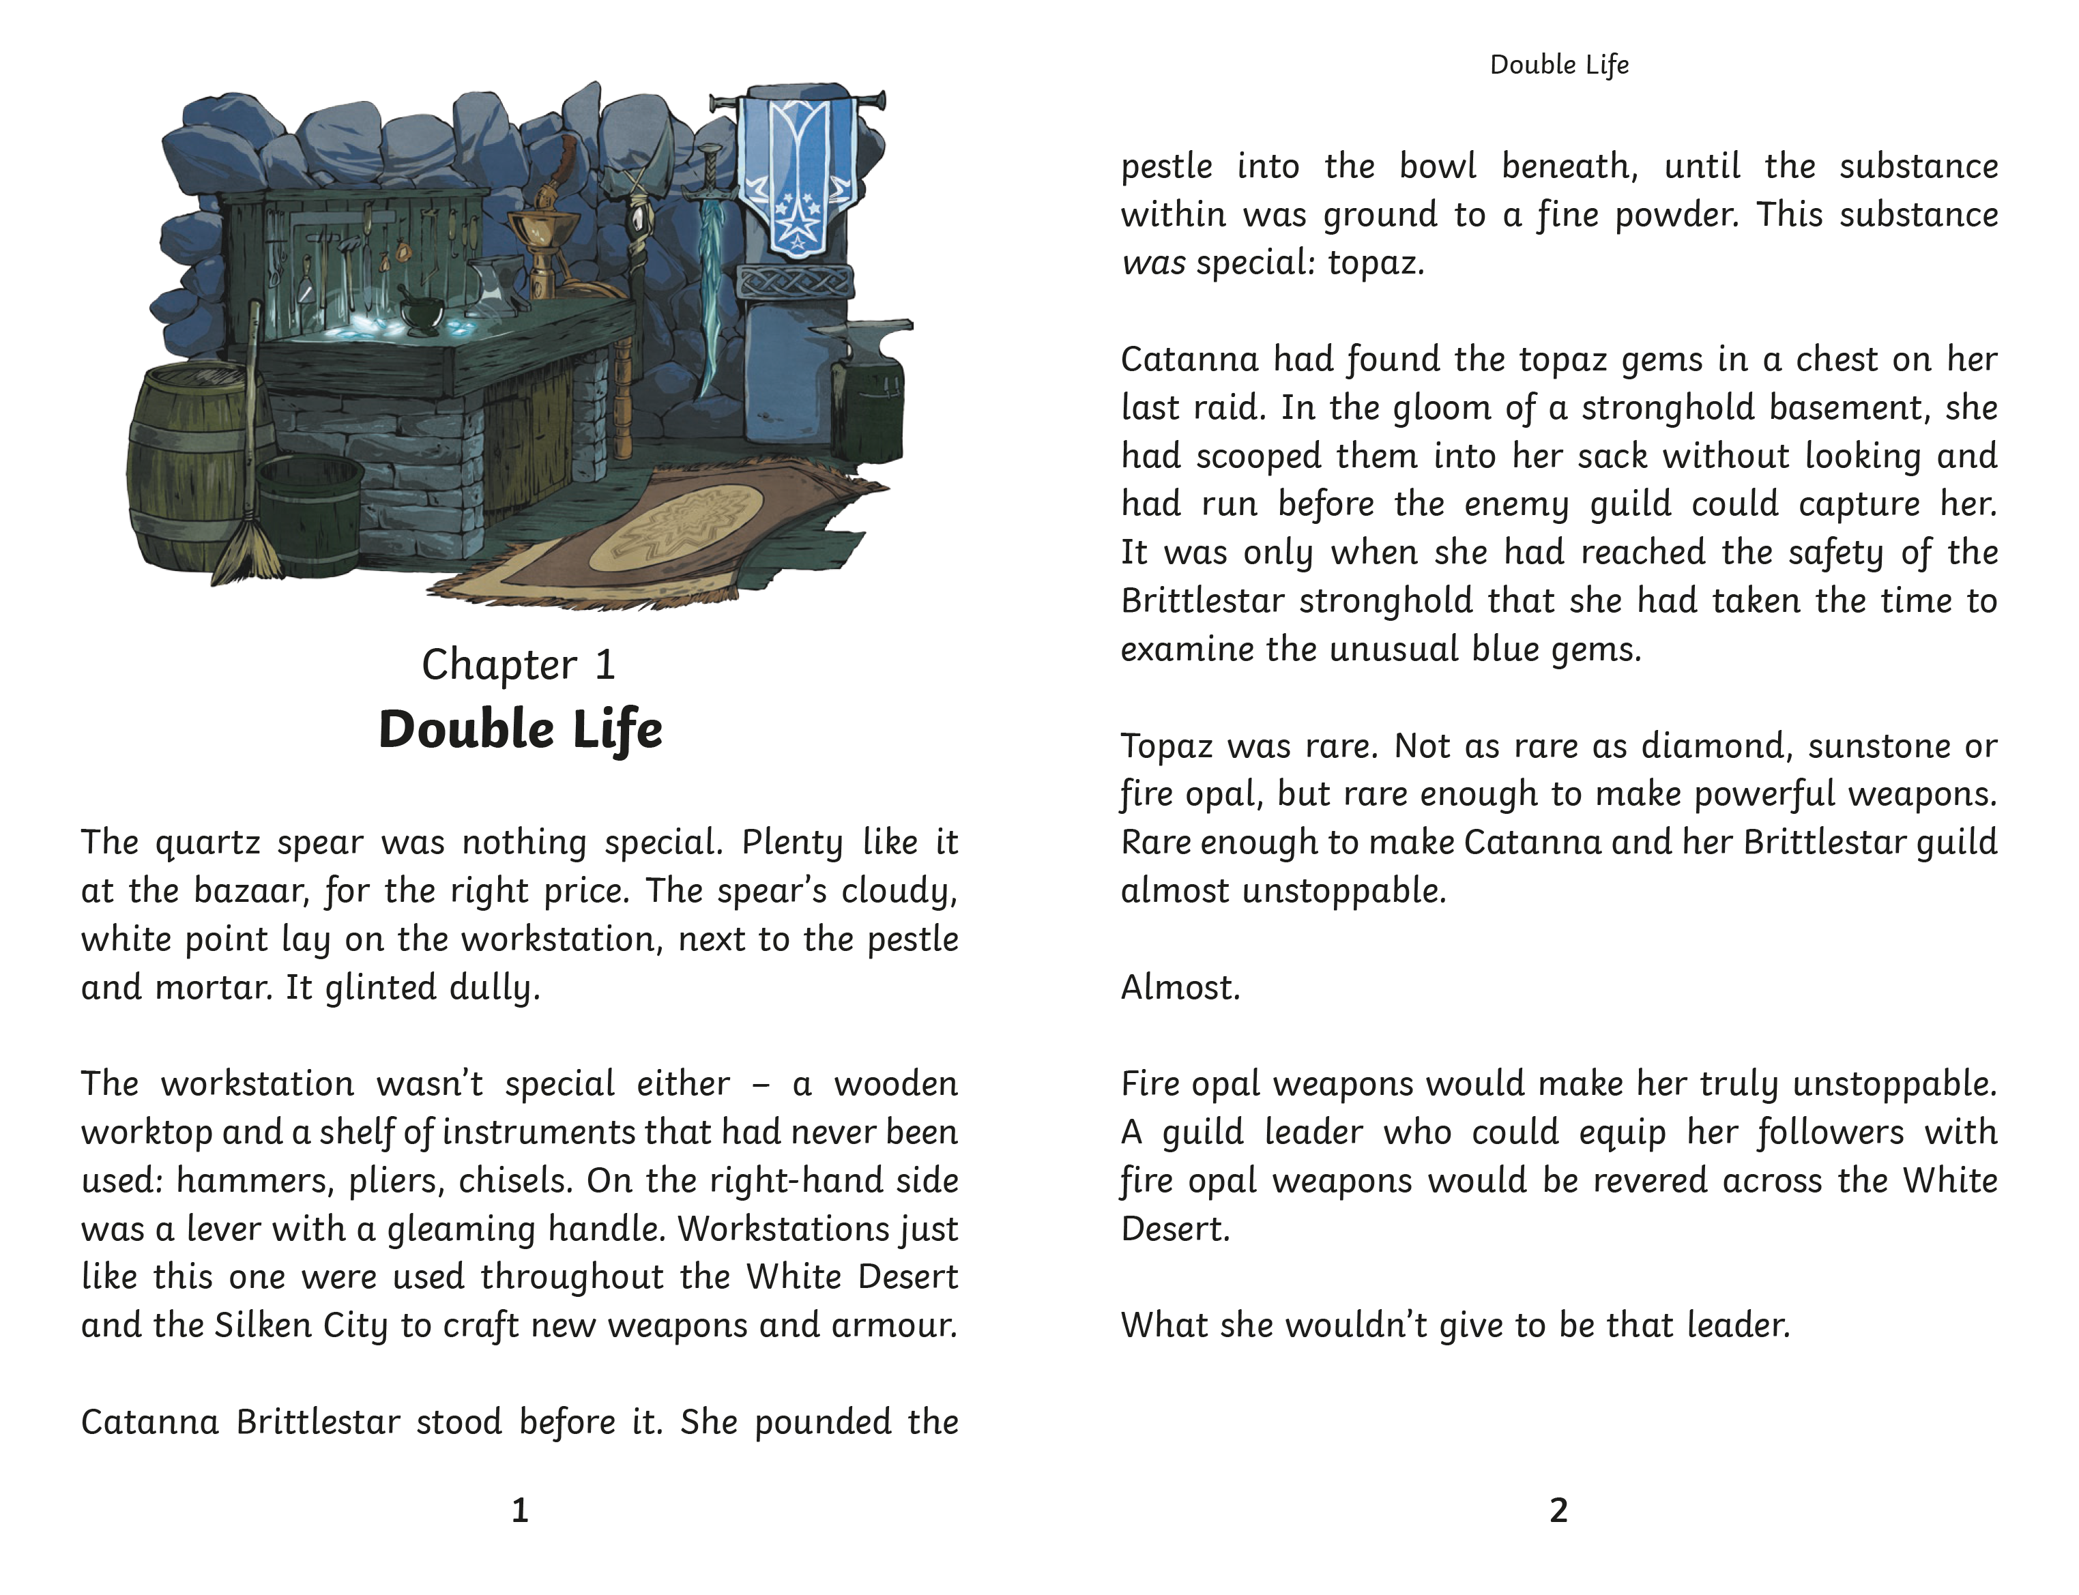
Back

Slide 13

Summing Up Summarising Sheba
Prove your understanding of what Summarising Sheba does by answering the following questions:
What does Summarising Sheba help you to do?
What sort of question might Summarising Sheba ask?
How can you make sure you get full marks
on Summarising Sheba questions?

